Slide 1

THEATRE NORTHWEST
Team Sparklers
CLIENT: 1. Dr. Patrick Immel
2. Wendy Eloe
TEAM MEMBERS:
Supraja Kumbam
Keerthi Chiduruppa
Saivarun Illendula
Rahul Reddy Lankala
Ashwith Gundu
Santhosh Bonala

Slide 2

Outline
Problem Statement
Proposed Solution
Project Requirements
Tools and Technologies
Demonstration
Future Tasks to be accomplished
Supraja Kumbam

Slide 3




Theatre appreciation students
Problem Statement:
Google Forms
Regular audience
Supraja Kumbam

Slide 4




Problem Statement:
Excel file
Mails
+
Google Forms
Supraja Kumbam
Documents

Slide 5



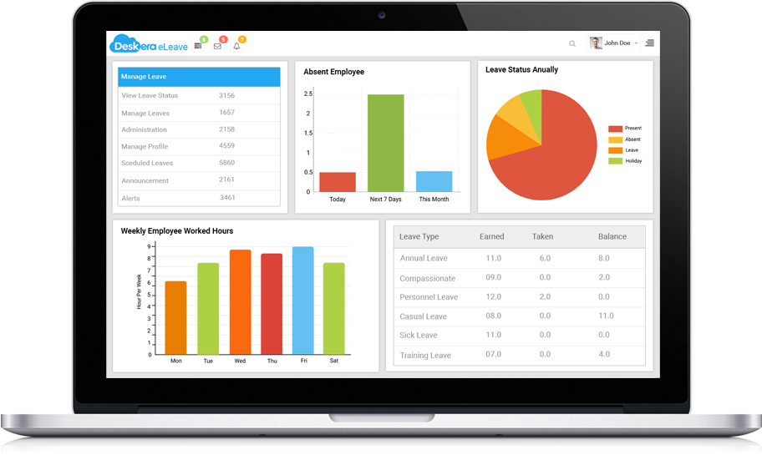
Proposed Solution:
Automatic Emails
Customized Reports
Dashboard
Web Application
Supraja Kumbam

Slide 6
Project Requirements:
S. No. | Requirements | Audience | Admin
1. | Login Feature | No | Yes
2. | Add New Show Functionality | No | Yes
3. | Reserve Tickets For Multiple Shows | Yes | Yes
4. | Search Functionality | Yes | Yes
5. | Confirmation Email | Yes | No
6. | Reminder Email | Yes | No
Keerthi Chiduruppa
Notes:
During the client meeting, the client has discussed some key requirements and their accessibility to the audience and the admin.

Slide 7
Project Requirements:
S. No. | Requirements | Audience | Admin
7. | Publishing and Unpublishing a Show | No | Yes
8. | Modify Existing Show Information | No | Yes
9. | Admin will be able to Add Another Admin | No | Yes
10. | Delete Show Functionality | No | Yes
11. | Report Generation Functionality | No | Yes
Keerthi Chiduruppa

Slide 8
Project Requirements:
S. No. | Requirements | Audience | Admin
12. | Duplicate a show | No | Yes
13. | Directions towards show venue | Yes | Yes
14. | Define the ticket type and price | No | Yes
15. | Create a show with multiple dates | No | Yes
Keerthi Chiduruppa

Slide 9





Technologies:
(Backend/Server)
API Calls
Deploy
Response for API Calls
+
DB Response
DB Request
(Frontend)
(Database)
Keerthi Chiduruppa
Notes:
Vue.js – It is an open source JavaScript framework for building interactive user interfaces. The main advantage of using Vue.js for the frontend development is that it is very simple to use and understand (as it is a mix of HTML, CSS and JavaScript languages) and it can be easily integrated into any existing application. (As Vue.js is a JavaScript framework it can be easily integrated into any application built using the JavaScript).
Bootstrap – Open source front end framework It contains html and CSS based templates.
https://vuejs.org/v2/guide/comparison.html
(Please refer to the link to find out what makes Vue.js a little better than Angular)
Nodejs - Node.js is a server-side platform built on Google Chrome's JavaScript Engine (V8 Engine). Node.js is an open source platform for developing server-side and networking applications. Node.js applications are written in JavaScript, and can be run within the Node.js.
running scripts server-side to produce dynamic web page content before the page is sent to the user's web browser.
Advantages:
1. Very Fast as it is built on Google Chrome's JavaScript Engine (V8 Engine).
2. Asynchronous and Event Driven means a Node.js based server never waits for an API to return data. The server moves to the next API after calling it and a notification mechanism helps the server to get a response from the previous API call.
MongoDB - MongoDB is a popular No-SQL database. It stores data in flexible, JSON-like documents making data easy to work with and analyze. MongoDB is free and open-source database and it is distributed in nature which means that data is located locally where it is mostly used, then the communication costs for data manipulation can be minimized. The advantage of having a distributed database is that even if there is a single point of failure, the system performance is not affected.

Slide 10





Tools
Postman
Visual Studio Code
GitHub
TortoiseGit
MongoDB Compass
Keerthi Chiduruppa
Notes:
GitHub - GitHub Inc. is a web-based hosting service. It is mostly used for storing, sharing and retrieving computer code. GitHub offers plans for both private repositories and free accounts. In our project we have created a private repository (using a student account) and added all the team members along with Hemanth. We have created a developer branch for our repository so that all the commits are made to the developer instead of the main branch to avoid any conflicts.
Postman - Postman is a powerful HTTP client for testing web services. Postman makes it easy to test, develop and document APIs by allowing users to quickly put together both simple and complex HTTP requests.
MongoDB Compass – MongoDB Compass is a GUI which displays the information about the MongoDB database and can also be used to perform queries.
Visual Studio Code - Visual Studio Code is a source code editor. It supports a number of programming languages and a set of features that may or may not be available for a given language.
TortoiseGit - TortoiseGit is a Git revision control client, implemented as a Windows shell extension (free software). Besides showing context menu items for Git commands, TortoiseGit provides the status of Git working trees and files. It also comes with the TortoiseGitMerge utility to visually compare two files and resolve conflicts.

Slide 11
Tasks Completed in GDP I
Gathered Requirements
Developed Prototypes
Setting up Front-end Environment (VueJs)
Setting up Back-end Environment (NodeJs)
Token Based Authentication for Admin Login
Developed Database Design
Saivarun Illendula

Slide 12
Tasks Completed in GDP I
Admin
Login Feature
Add New Show Feature
Add New Admin Feature
Delete Show Feature
Generating Sample Reports
Adding New Section Feature
Saivarun Illendula

Slide 13

Tasks Completed in GDP II
Admin
Edit Show Feature
Reserve Tickets Feature
Duplicate Show Feature
Multiple Dates for a Show
Custom Ticket Criteria Feature
Announcement Email Feature
Publish and Unpublish a show
Search Functionality
Edit and Delete Admin Feature
User
Dashboard
Cancel Ticket
Directions
Search Functionality
Saivarun Illendula

Slide 14
Problems Faced
Generating a Map for the User
Handling multiple dates for a show
Duplicating a show
Handling Images on Backend instead of Database

Slide 15
Ashwith Gundu
Rahul Reddy Lankala
Santhosh Bonala

Slide 16







Future tasks to be accomplished
Reminder Emails to Audience
User show reservation
Report Generation for Admin
Cancel Ticket Feature for Admin
Confirmation Emails to Audience
Deployment
Create User and Developer manual
Ashwith Gundu
Notes:
Reminder Emails : These are emails which are preset with subject and body, they are sent to the audience one day before their show time.
User Show reservation : We need to develop a model for the user where he/she can reserve ticket
Report generation : A excel report will be generated for the admin with consisting of various sheets like audice of a particular show, only theatere appreciation students
Cancel : Admin shall be
Confirmation emails: It is sent to the audience once he/she reserves a ticket
Deployment: we need to deploy the application on platforms like heroku
Finally we

Slide 17
THANK YOU

